Slide 1
Support Vector Machines
Lagrange Multipliers
& The Dual Problem
From the primal formulation to the dual — step by step
DATASCI 224 | Chrissie Lok
Notes:
Emma walked us through what SVM is trying to do and what the margin means. My goal is to show you how SVM actually solves that problem — and why the method we use turns out to be more powerful than just finding the answer directly.

Slide 2
Where we left off
The Primal Problem
Minimize ½‖w‖²
Subject to
yᵢ(wᵀxᵢ + b) ≥ 1 for all i
"Which training
points actually
define the
boundary?"
Lagrange Multipliers
Absorb constraints into the objective
The Dual Problem
Eliminate w and b — solve for α only
— The dual answers this precisely
Notes:
So we have the primal — our goal is to minimize ½‖w‖² while making sure every training point is correctly classified. We know the goal, but getting there is the problem. Every training point has a constraint attached to it, and traditional calculus only works cleanly when you can optimize freely without restrictions — those constraints are blocking us from solving it directly.
Think of it like trying to find the lowest point on a mountain but certain paths are blocked — you can't just walk freely downhill, the restrictions force you to take a different route. That different route is exactly what the next few slides cover. But before we get there, the key question driving my whole section is this — which training points actually define the boundary? Not all of them do, and by the end of my section you will know exactly which ones matter and why
**primal constraint: every single training point must be correctly classified and sitting outside or exactly on the margin boundary.

Slide 3
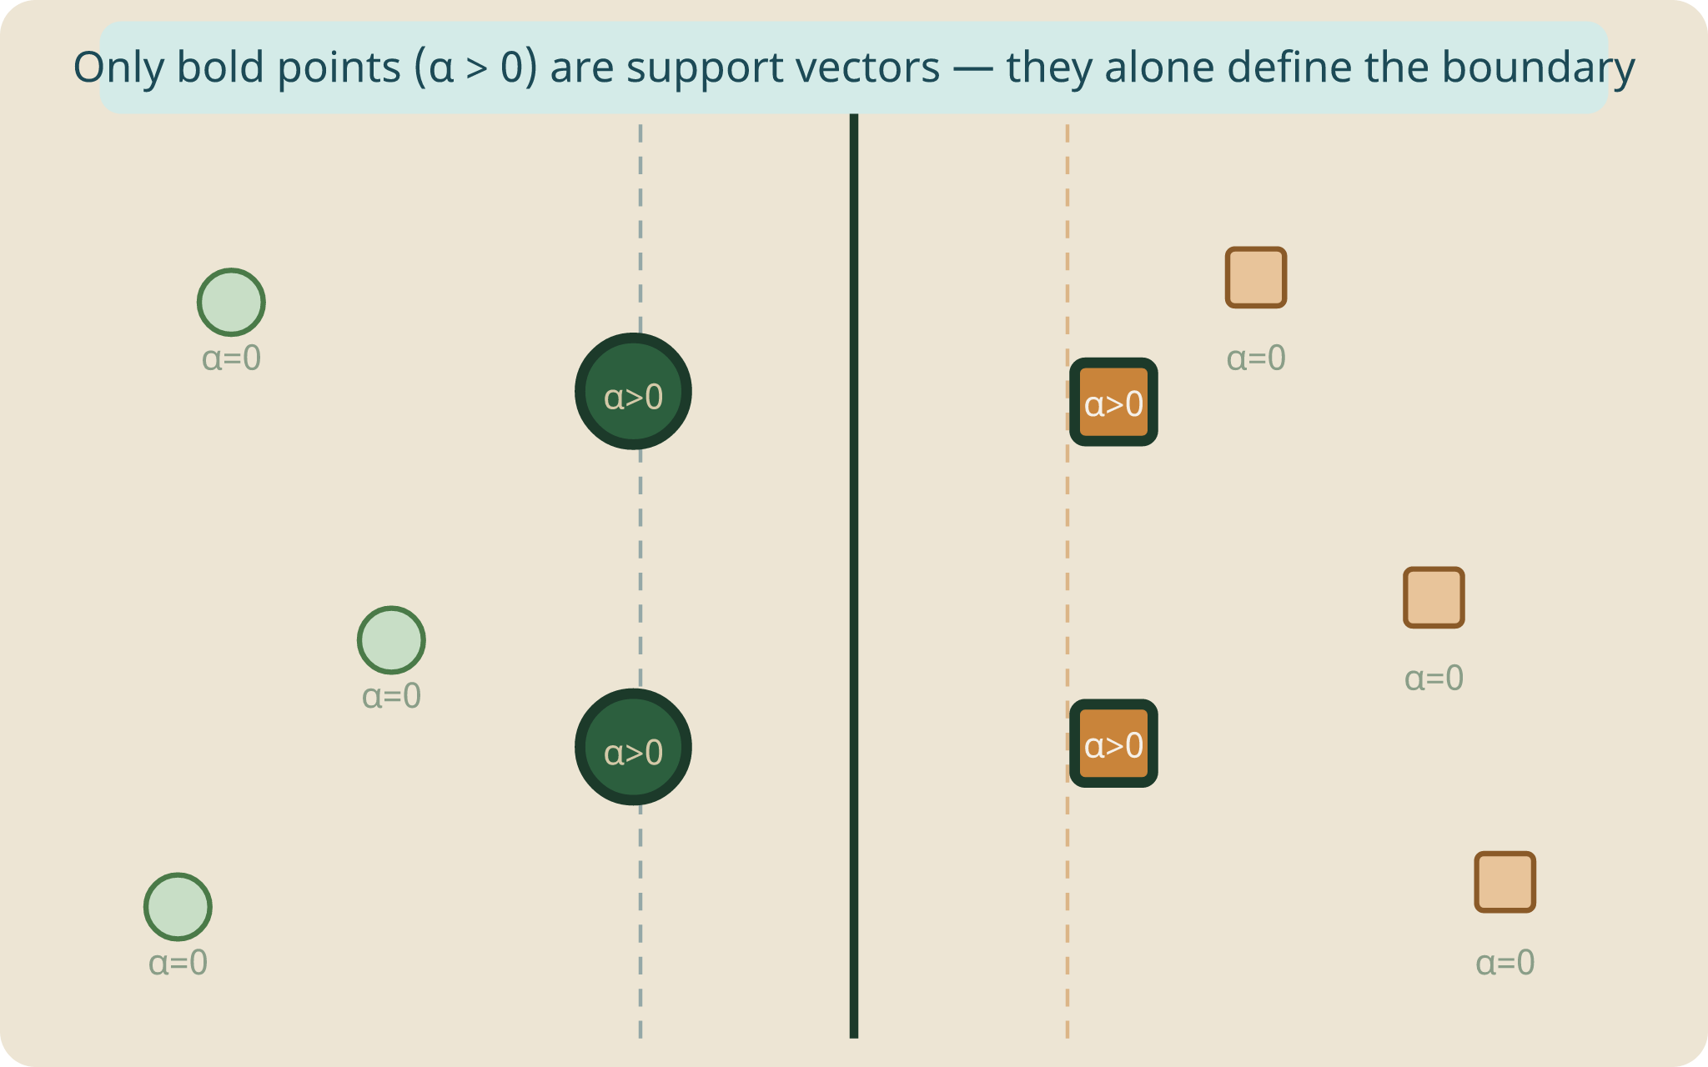
Lagrange Multipliers
Turning a constrained problem into an unconstrained one
The Problem and the Fix
We can't just take a derivative when constraints exist — the minimum might be on the constraint boundary, not where the gradient is zero.
Introduce a multiplier αᵢ for each constraint and absorb the constraints into the objective — now we can optimize freely.
The SVM Lagrangian
L(w, b, α) = ½‖w‖² − Σᵢ αᵢ [ yᵢ(wᵀxᵢ + b) − 1 ]
½‖w‖² Original objective
αᵢ ≥ 0 Multiplier per point
yᵢ(wᵀxᵢ+b)−1 The constraint
Notes:
To handle those constraints, we use the Lagrangian — a combined function that absorbs every constraint directly into the objective by multiplying each one by a new variable called alpha-i.
Instead of the constraints sitting outside as separate rules, they're now folded into one single function we can work with using calculus. Think of it like a river blocking your path on that mountain — instead of treating it as a barrier, we absorb it into our map.
We introduce one alpha-i per training point. At this stage alpha is just being introduced as an unknown — its actual values get determined later. But intuitively, alpha-i represents how influential each point is in shaping the boundary. A large alpha means that point is pulling the boundary strongly toward itself — and a zero alpha means it plays no role at all.
**ONLY PATH THAT LEADS TO THE DUAL
** The Lagrangian absorbs the constraints into the objective by multiplying each one by αᵢ and subtracting it. Now the constraints are baked into the function itself — the wall is no longer a separate barrier, it's part of the landscape. And now you CAN differentiate freely because the constraint information is already inside the function, automatically penalizing any violation.

Slide 4
KKT Conditions
The 5 conditions that must hold at the optimal solution
1
Stationarity — w
∂L/∂w = 0 → w = Σᵢ αᵢ yᵢ xᵢ
w is a sum of training points. Only support vectors contribute.
2
Stationarity — b
∂L/∂b = 0 → Σᵢ αᵢ yᵢ = 0
Multipliers weighted by labels must balance to zero.
3
Primal feasibility
yᵢ(wᵀxᵢ + b) ≥ 1
Every point stays on the correct side of the margin.
4
Dual feasibility
αᵢ ≥ 0
Multipliers must be non-negative.
5
Complementary slackness
αᵢ [ yᵢ(wᵀxᵢ + b) − 1 ] = 0
αᵢ = 0 (not a support vector) OR constraint is tight (support vector).
Notes:
Now that we have the Lagrangian, we need to find its optimum. The KKT conditions are the five rules that must all be satisfied simultaneously for us to accept a solution as the true optimum — think of them like a checklist where every box must be ticked at the same time. They also give us the tools to simplify the Lagrangian into the dual.
The first condition tells us w is built entirely from the training points themselves — specifically a weighted combination of them using the alpha values.
tells us what w equals at the optimum → when substituted back, w disappears from the Lagrangian
In plain English: w is built from the training points.
Imagine you have 569 tumour samples. Each one gets multiplied by three things — how important it is (αᵢ), which class it belongs to (yᵢ), and its actual features (xᵢ). You add all of those up and that gives you w.
The second is a balance rule — the pull from the positive class must exactly cancel the pull from the negative class.
In plain English: the two sides must balance perfectly.
Think of it like a perfectly balanced seesaw. The weight on the malignant side must exactly match the weight on the benign side. If one side is heavier the boundary tips toward it — which means it's not in the optimal position anymore.
This condition is what causes the b term to vanish when we substitute back into the Lagrangian — because the b term in the Lagrangian contains Σᵢ αᵢ yᵢ, and since that equals zero, the whole b term becomes b × 0 = 0 and disappears.
Second condition → tells us the alphas must balance across classes → when substituted back, b disappears from the Lagrangian
The third simply confirms every training point is correctly classified — just a sanity check.
The fourth says every alpha must be non-negative — the multipliers can only pull toward satisfying the constraint, never push in the wrong direction.
The fifth — complementary slackness — is the most important one. Think of it like a light switch — every point is either fully off, meaning alpha is zero and it plays no role, or fully on, meaning it sits exactly on the margin as a support vector. In our breast cancer dataset of 569 tumours, maybe only 20 or 30 end up as support vectors — the rest are simply switched off and contribute nothing to the boundary.

Slide 5
Deriving the Dual
Substitute the KKT conditions back into L — w and b disappear completely
1
Substitute w = Σᵢ αᵢ yᵢ xᵢ → the w terms collapse into inner products:
½‖w‖² becomes ½ Σᵢ Σⱼ αᵢ αⱼ yᵢ yⱼ (xᵢᵀxⱼ)
2
Use Σᵢ αᵢ yᵢ = 0 → the b term vanishes entirely
b · Σᵢ αᵢ yᵢ = b · 0 = 0 ✓ (b is gone)
3
What remains — the dual objective (α only, no w or b):
W(α) = Σᵢ αᵢ − ½ Σᵢ Σⱼ αᵢ αⱼ yᵢ yⱼ (xᵢᵀxⱼ)
Constraints: αᵢ ≥ 0 and Σᵢ αᵢ yᵢ = 0
Notes:
This is the core of my section. We take the two stationarity conditions from the KKT checklist and substitute them back into the Lagrangian. Think of it like a recipe — we start with w, b, and alpha all mixed together, and by the end only alpha remains. The b term vanishes because the balance condition makes it multiply to zero. The w terms collapse into inner products between training points. What's left is the dual — a clean function of alpha only.
**constraint 1: every training point either has no influence on the boundary — alpha is zero — or it pulls the boundary toward itself — alpha is positive. No point can push the boundary away.
**constraint 2: the boundary must be balanced — the pull from one class must exactly cancel the pull from the other class. If one side pulled harder than the other the boundary would tip toward it and wouldn't be in the optimal position anymore.

Slide 6
Why the Dual Matters
01
02
03
Sparsity
Dimensionality
The Kernel Trick
Most αᵢ = 0. Only support vectors (αᵢ > 0) define w. All other training points are irrelevant — delete them and nothing changes.
Primal has d+1 variables (one per feature). Dual has n variables (one per point).
The dual only uses xᵢᵀxⱼ — inner products. Replace these with K(xᵢ, xⱼ) to find nonlinear boundaries without ever computing the features explicitly.
Notes:
Three reasons this matters. First, sparsity — most alphas are zero so the boundary is defined by just a handful of support vectors, like a suspension bridge held up by a few cables.
Second, the dual solves for n alpha values instead of d feature weights — making it computationally cheaper when features outnumber training points.
Third — and this is the handoff to Siddharth — because the dual only uses inner products, we can swap them for a kernel function to find nonlinear boundaries.
Scikit-learn handles all of this automatically — the Lagrangian, the dual, and the SMO solver all run the moment you call model.fit(). The theory we covered today is exactly what is happening inside that one line of code.

Slide 7
Applying SVM to Breast Cancer Classification
Research Question
"Can a Support Vector Machine accurately classify breast tumours as malignant or benign, and how does the choice of C affect its performance?"
1
2
3
Nonlinear Boundary
Support Vectors
Role of C
The boundary between malignant and benign tumours may not be linear in the 30-dimensional feature space. Because the dual uses inner products, a kernel can be applied.
After solving, only a handful of borderline tumour samples become support vectors. These are the hardest cases to classify and define the entire decision boundary.
C directly controls how aggressively the model classifies every training tumour. In a medical context this has real clinical implications.
Notes:
Connecting this to my research — the boundary between malignant and benign tumours might not be linear in that 30 dimensional feature space, but because the dual uses inner products we can apply a kernel to handle that.
After solving, only a handful of borderline tumour samples become support vectors — the genuinely ambiguous cases that define the boundary. And the choice of C directly controls how aggressively the model classifies every training tumour, which in a medical context has real clinical implications — misclassifying a malignant tumour as benign is far more dangerous than the other way around.

Slide 8
Thank You
Any questions?

Slide 9
Variable Reference
Lagrangian
KKT Stationarity Conditions
L(w,b,α) = ½‖w‖² − Σᵢ αᵢ[yᵢ(wᵀxᵢ+b)−1]
w = Σᵢ αᵢ yᵢ xᵢ Σᵢ αᵢ yᵢ = 0
½‖w‖²
Objective — minimize to maximize margin
w
Built entirely from support vectors
‖w‖
Length of the weight vector w
αᵢ
Multiplier — zero if not a support vector
w
Weight vector — orientation of boundary
yᵢ
Label — determines direction of pull
b
Bias — where the boundary sits
xᵢ
Training point — feature vector
Σᵢ
Sum over all n training points
Σᵢ αᵢ yᵢ
Must equal zero — two classes balance out
αᵢ
Lagrange multiplier — influence of point i
Dual Objective
yᵢ
Label: +1 malignant, -1 benign
W(α) = Σᵢ αᵢ − ½ Σᵢ Σⱼ αᵢ αⱼ yᵢ yⱼ (xᵢᵀxⱼ)
xᵢ
Training point i — vector of 30 features
W(α)
Dual objective function — what we maximize
wᵀxᵢ + b
Score for point i — which side of boundary
Σᵢ αᵢ
Sum of all multipliers — total influence
yᵢ(wᵀxᵢ+b)−1
Constraint rearranged to equal zero at margin
Σᵢ Σⱼ
Double sum — every pair of training points
αᵢ αⱼ
Zero if either point is not a support vector
yᵢ yⱼ
Same class = +1, opposite class = -1
xᵢᵀxⱼ
Similarity score — replaced by kernel K(xᵢ,xⱼ)
Notes:
Pairs appear because squaring w — which is itself a sum over all training points — forces every training point to interact with every other training point. Squaring any sum always gives you pairs.
For the lagrangian: This is called a minimax problem. You're simultaneously:
Minimizing over w and b — finding the best boundary
Maximizing over α — enforcing the constraints as tightly as possible
For the dual:
When we flip the order — maximizing over α first, then minimizing over w and b — that's what gives us the dual. And because SVM is convex, strong duality guarantees that flipping the order gives the exact same answer.
Why we flip the order:
When we do it in the primal order — minimize over w and b first, then maximize over α — we're stuck working with w and b directly. That's expensive and limits us to linear boundaries.
But when we flip it — maximize over α first, then minimize over w and b — something magical happens. The inner minimization over w and b can be done analytically using the KKT conditions.
Why its cheaper to solve using dual instead of primal:
w is a vector with one entry per feature. So if your dataset has 30 features like your breast cancer dataset, w has 30 values to solve for. If you have a text classification dataset with 100,000 words as features, w has 100,000 values to solve for.
The computational cost of solving the primal scales with the number of features d. The more features you have, the bigger w is, and the more expensive it is to solve for directly.
The dual solves for α instead
α has one entry per training point — not per feature. So if you have 569 tumour samples, you solve for 569 alpha values regardless of how many features each tumour has. The computational cost scales with the number of training points n, not the number of features d.

